Slide 1
Sample rate test – 7 January
Measurement | Set rate (Hz) | Period measured | Rate meas
0107_1734_sample_rate_test | 200 | 0.01702 | 58.76
0107_1726_sample_rate_test | 200 | 0.01687 | 59.26
0107_1724_sample_rate_test | 100 | 0.01698 | 58.89
DUT is 2nd H2 sensor while in full H2 gas
Set sample rate to max 200 Hz, but the resulting rates only got to just below 60Hz
Therefore this makes it impossible to tell if the noise is coming from the electricity network (50Hz, so >100Hz sample is needed to measure it (Nyquist))
Storing data on the device might enable this faster measurement, but it is going to take some time to figure this out
OR use one of the multimeters

Slide 2
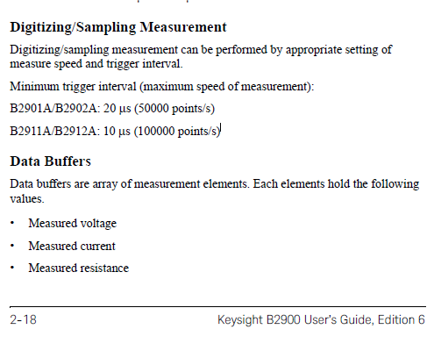
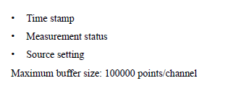
Maximum possible sample rate of SM B2901A
Max sample rate: 50 kHz
Buffer size: 1E5 points per channel
Measurement time at max sample rate: 2s
sourcemeter Keysight B2901A - user guide
2-19

